Slide 1
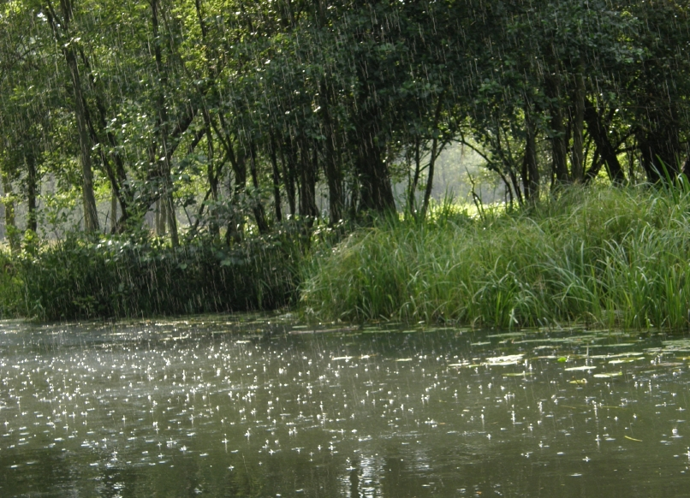
Water Literacy Symposium 10/5,6/ 2012/
Water circulation
in nature and our lives
Teruo YOSHINO
International Christian University
1. In micro scale: dynamic motion of
water molecules
2. In ordinary scale: water in our body 3. In macro scale: water cycle in nature 4. Our earth is a water planet
Notes:
Before starting my presentation, I have to mention briefly about my background for Water Literacy.
I have experiences of talking about water issues to university students, scientists and citizens who have interests in science. So, I am not confident what and how to teach water issues to young people.
Then, my presentation is to give teachers a bunch of basic scientific knowledge which may open kids’ eyes toward uniqueness and significance of water, and the relationship with human being.
The key-word is “water circulation” considering in different scales.

Slide 2
Water has 67 unique properties
・Water density anomalies
・Water material anomalies
・Water thermodynamic
anomalies
・Water physical anomalies
These unique properties are
basis of our life and natural environment.

Slide 3
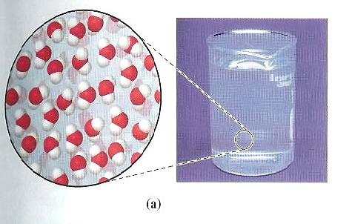
Moving water molecules Simulation of the freezing process of water
Dr. Iwao Omine
Director of Molecular
Science Res. Center

Slide 4
．2. In Ordinary scale: water sustains life
・circulation in plants：
Rain water
Water absorbed from roots moves up to
trunk and leaves with carrying minerals and nutrition for sustaining life.
Finally, water evaporates from leaves to air.

Slide 5
． ・Circulation in our body
・Water circulates in our body
through blood capillary,
carrying nutrition and oxygen
to the terminal.
・A man takes 2 liters water and
discharge the same amount,
but water is recycled about
100 times in a body by
removing wastes with kidney.
Kidney

Slide 6
O₂
Photo-synthesis？
H₂O
Green plants produce glucose and oxygen from water and carbon dioxide by sunlight (solar energy).
CO₂
sunlight
H₂O
6 H₂O + 6 CO₂ C₆H₁₂O₆ + 6 O₂
Green plant
carbon
dioxide
Glucose →starch (nutrition)
cellulose (body)
oxygen
Water
Meaning of photo-synthesis:
Water and carbon dioxide are “cinders” produced by
burning and respiration to earn energy.
Reproducing system to change “cinders” to useful
materials (nutrition) and oxygen.
Photo-synthesis is an essential natural factory
to sustain lives of plants and animals on the Earth.

Slide 7
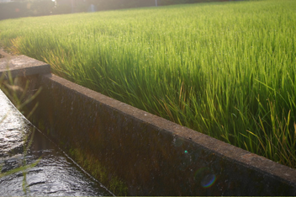
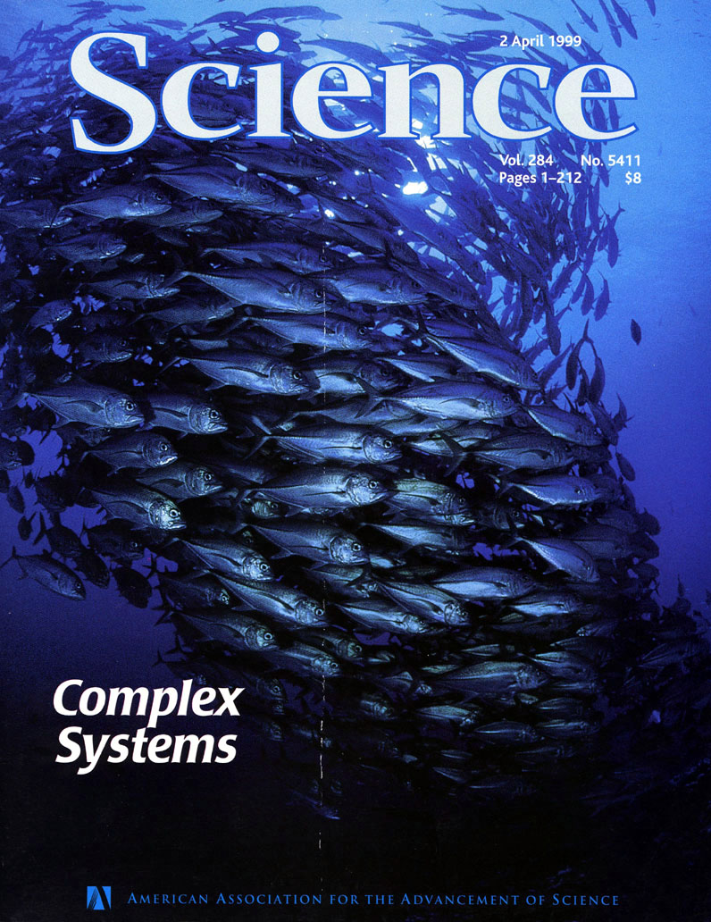
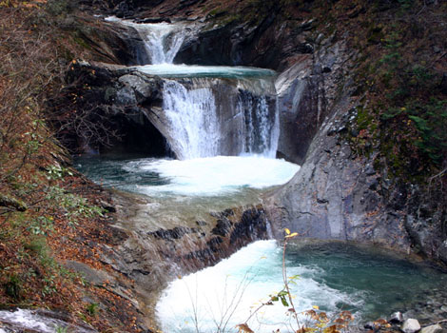
3. In macro scale: water cycle in nature
Various appearances of water in nature
Cloud
Trees, river, grasses, rain
agricultural field
River
Snow & glacier
Sea

Slide 8
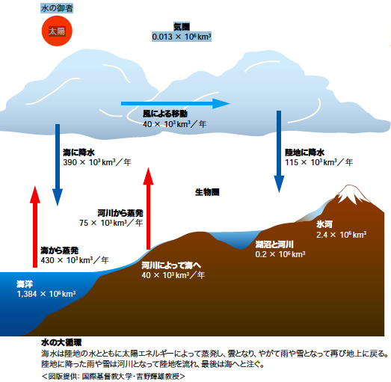
Controler of water
Water Cycle in Nature
Sun
Energy flow in nature
Cloud
Cloud
move with wind
40x10³km³/year
Rainfall
Vapor
Rainfall
115x10³km³/year
Rain/Snow
In plants &
animals
Rain/Snow
from river
Glacier
Vaporization
from sea
River/Lake
Glacier/Snow
40x10³km³/year
Lake
Sea: 71％ of surface
Sea
River/Ground water
Notes:
視野を地球全体に向けましょう。
一体、水はこの地球上のどこにあり、どのような役割を果たしている
のか最大限に目を開いて考えてみましょう。
地球表面の70％が水で覆われています。太陽熱により絶えず蒸発し、雲となり、雨や雪として再び地上に戻ってきます。蒸発した海水の9割は海の上に落ちますが、1割の40億トンは風で陸上に運ばれてから落ちます。40 40億トンの水は川として陸地を流れ、地中水となり、地上の動植物の生命活動を支え、また海へと戻ります。これを水の大循環と言います。数十億年前に今の水量となって以来、総量は変わらず循環しているのです。
この水の大循環の意味を考えて頂きたいのです。難しくない。
2,3の意味をここであげますと、
1.
2.

Slide 9
Meaning of water cycle
● Natural system changing sea water to clean water.
（40 tera ton-a-year regularly provided in free gratis）
● Energy flow and energy resource（hydro power）.
rain water in the mountainous area（40 tera ton-a-year ）
● “Water resource”: moving water (river and ground
water) from land to sea. （40 tera ton-a-year ）
・Water resource：for agriculture、industry、domestic life.
・Sustain lives of all plants and animals
・Refresh and offer comfortable environment to men.
● Sustain the mild climate of the earth.
Prevent the surface of earth from overheating by sunlight
as vaporizing sea water and absorbing carbon dioxide .
（+15℃, average atmospheric temp.）
Water cycle is a life-sustaining cycle.

Slide 10
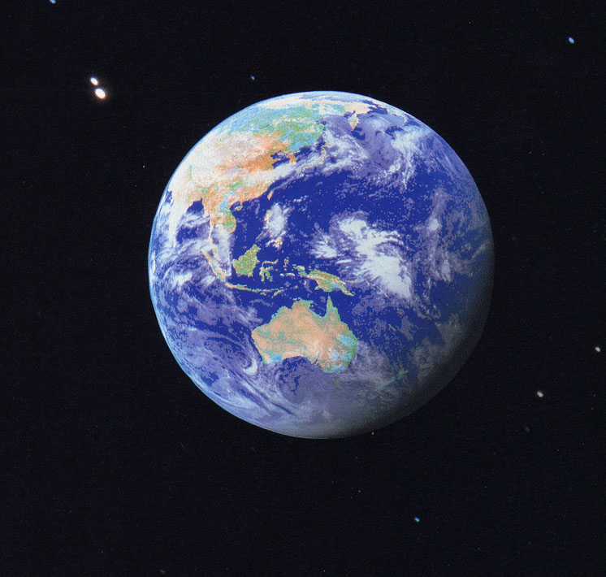
4. Our earth is a water planet
・Why water (sea) existing
planet ?
・Why life-bearing planet ?
Why only the earth in 8 planets in the solar
system has a large amount of liquid water ?
Required conditions to become water planet:
Atmospheric temp. 0 - 100 ℃（1 atm）

Slide 11
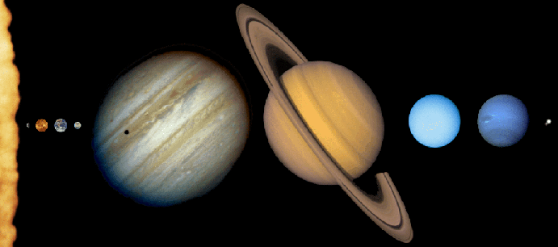
8 Planets in the solar system
Sun
Earth
①② ③ ④
⑦
⑧
⑤
⑥
1st condition：Distance from the Sun
・
Planet： Mercury Venus Earth Mars Jupiter Saturn Uranus Neptune
Surface ：330 200 15 -50 -130 -150 -190 -200 （℃）
temp
① ② ③ ④ ⑤ ⑥ ⑦ ⑧

Slide 12
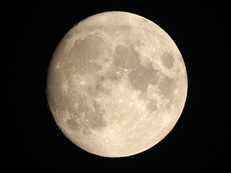
2nd Condition: size
・
No water on the Moon.
Why?
Distance between the Sun
and the Moon/Earth is almost same.
Moon
Gravitation of the moon:
1/6 of the earth
Surface temp. of the Moon:
110℃ in the daytime
-180℃ at night
The Earth fills the two conditions by a miracle,
and then became water planet.
Notes:
12

Slide 13
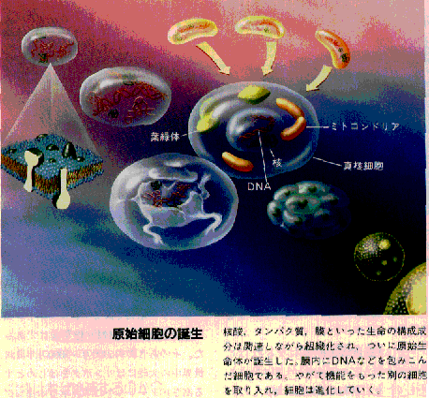
Why living organisms exist in the Earth？
(Hypothesis）
Life generated in the sea 3.8 billion years ago.
Genesis of living organism
▼All organisms including
animals hold water
to sustain their life.
Image of archaeocyte
(original cell) in the sea
▼ Human species appeared 2 million years ago,
holding water, 2/3 of their weight, necessary
for sustaining the life.

Slide 14
Summary
Water circulates in our body to sustain life and domestic lives, as well as in nature to control
the natural environment and climate.
2. All living organisms including men need water to live, and have to share the limited amount of clean water(40 tera ton-a-year) provided gratis
by water cycle in nature.
3.The earth is a unique planet where water exists as liquid and always circulates on the Earth to make it possible for various lives to be generated and sustained.
4. These basic and global knowledge should be
given to young people and connected with their local acts and experiences to be shared.

Slide 15
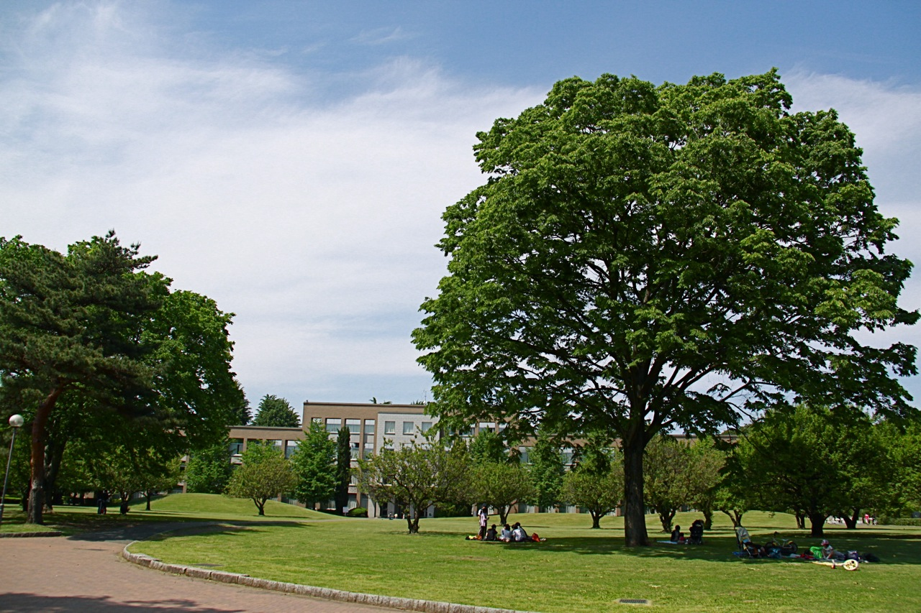
Thank you for your attention !

Slide 16
JST(日本科学技術振興機構）発行
http://sciencewindow.jp/mizu/
http://sciencewindow.jp/mizu/

